Slide 1

Assessment, Recording and Reporting parent workshop
Friday 26th September, 2025
Mr. S Bromley, Assistant Head of Secondary (Assessment, Recording & Reporting)
*Progress reports
*Triangulation of data using the GL Education suite
*ISB Assessment Calendar
*Parents' Evenings
*Academic Confidence days
*Student Self-Reflections
*Settling in reports

Slide 2
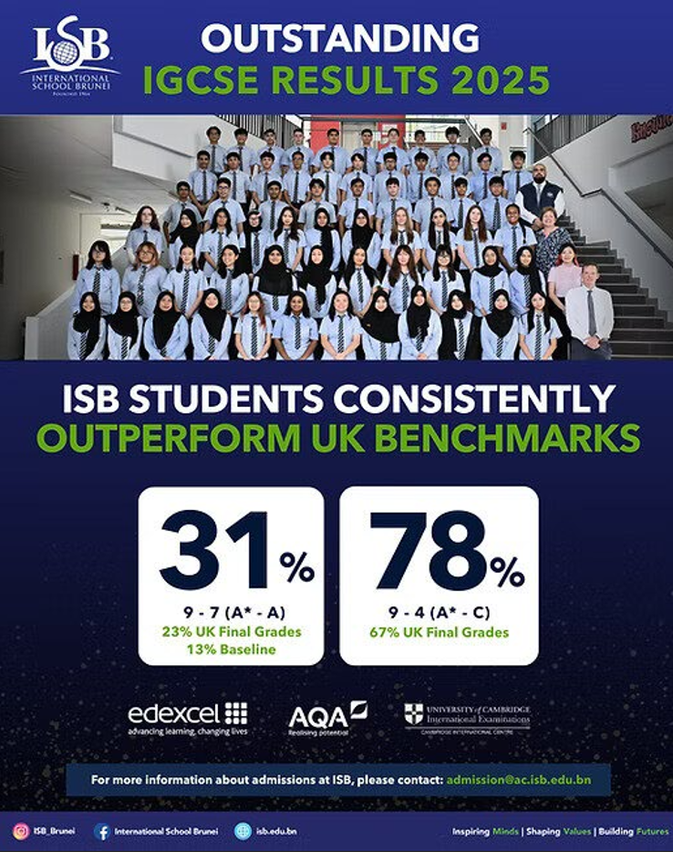

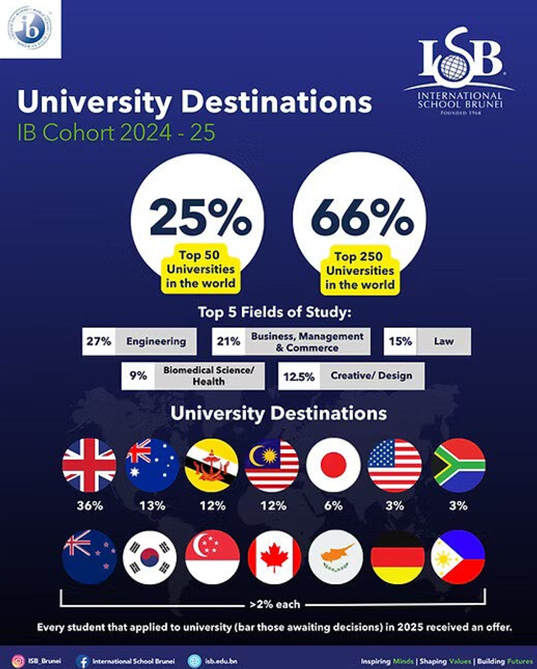
Notes:
IGCSE – 78% 9-4 (A*-C)
IB – 42 top point score, with ave. grade of 33.5
Top Global University destinations
ISB is proud to be an inclusive international school that ensures every child, no matter their interests or needs, excels.
ISB provides a holistic education where every student is appropriately challenged, develops intercultural understanding and gains the skills and values necessary for active global citizenship.

Slide 3

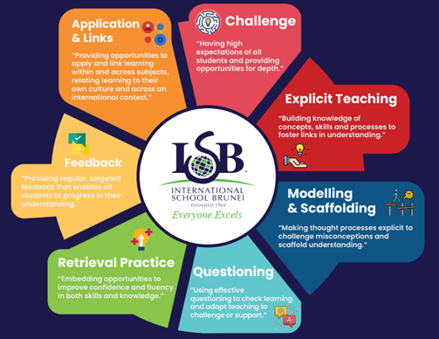
Notes:
At ISB, high quality teaching and learning (HQTL) is the ability to support every student in terms of their academic, personal and social growth. It is about providing students the opportunity to develop not only subject related knowledge, but the wider values, understanding and skills needed to become confident and responsible global citizens.
Based on the work of educational research and school leaders, the Secondary 7 sets out the core principles of effective learning and teaching which features in ‘every lesson, every day'.

Slide 4








Slide 5
ASSESSMENT

Slide 6
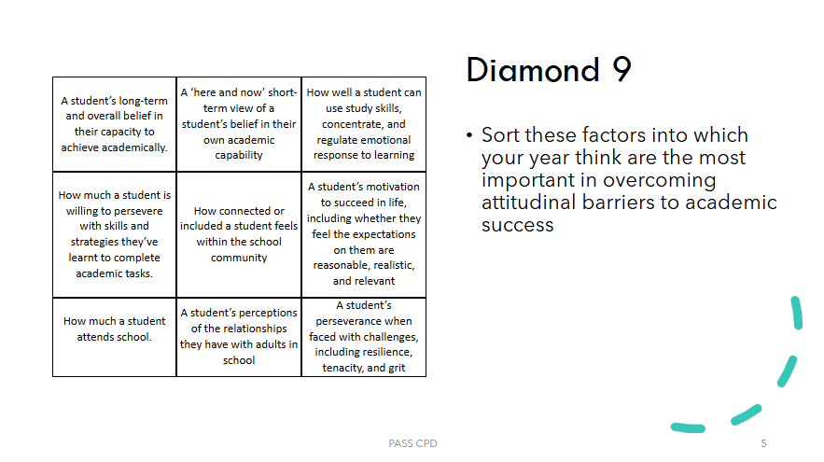
Task
Notes:
Print and handout

Slide 7
What is academic confidence?
Perceived Learning Capability and Learner Self-regard measure a learner’s short-term and long-term view of their “self-efficacy” for academic achievement respectively.
  - Self-efficacy describes a learner’s feelings about their ability to achieve success and the goals they have set themselves.
Confidence in Learning measures a student’s ability to persevere when faced with challenges. It focuses on their perseverance, resilience, tenacity and grit and links closely to self-efficacy. Lambros (2019)
Notes:
The Pupil Attitudes to Self and School (PASS) Survey is a digital assessment designed for schools to understand students' mindsets towards learning and their overall wellbeing. By asking students a series of questions on attitudes and feelings about school, the survey helps identify potential barriers to learning, such as low confidence, disengagement, or attendance issues, and informs interventions at individual, class, or school levels.

Slide 8
High Quality Learning & Efficacy?
Efficacy beliefs are formed through the interpretation of four principal sources of information (Bandura, 1977, 1989, 1997), namely:-
Mastery experiences relating to achieving academic goals
Vicarious experiences through observing others, such as classmates
Social persuasions through the messages and feedback they get from others
Emotional arousal or how their own feelings affect their confidence.
Notes:
The outcomes of high-quality learning at ISB can be seen in ISB students becoming:-
creative, confident, responsible and independent individuals who aspire to achieve their full potential.

Slide 9
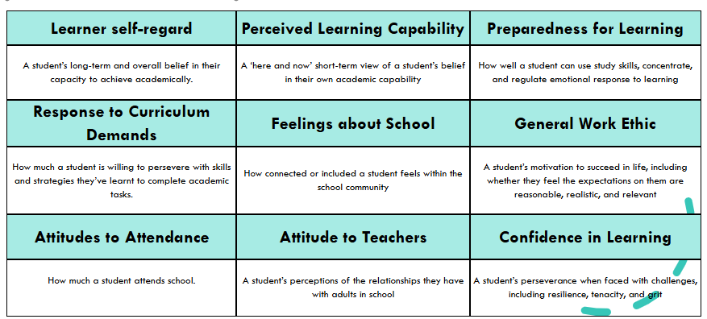
9 PASS Factors

Slide 10
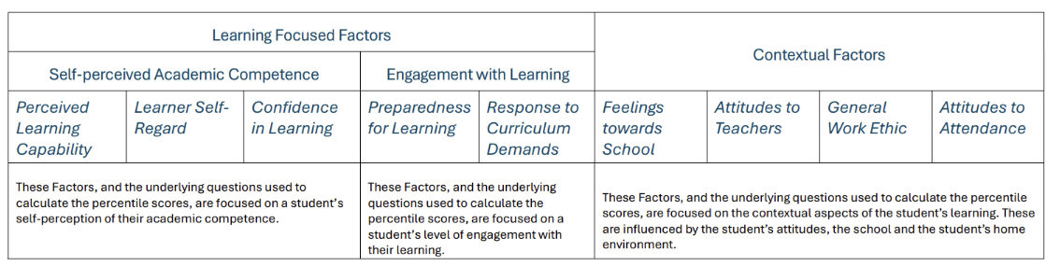
PASS Factors - Grouped

Slide 11
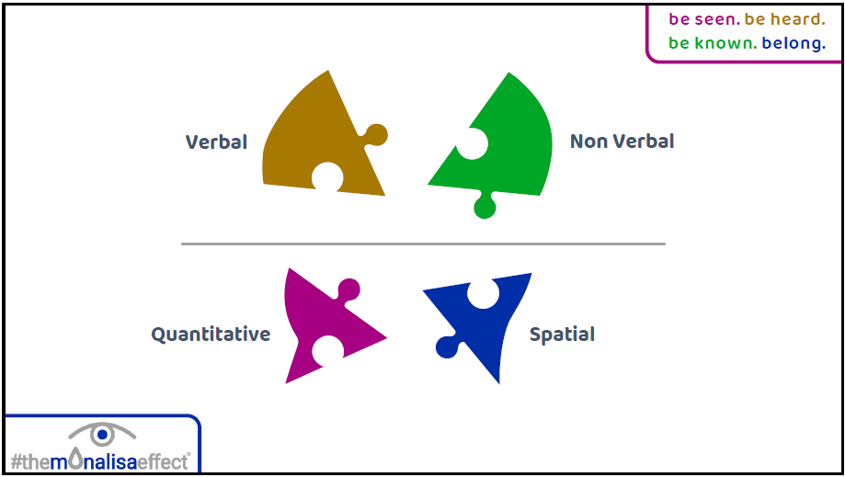
Notes:
The Cognitive Abilities Test (CAT4) is a standardized assessment for students aged 6-17 that measures Verbal, Quantitative, Non-Verbal, and Spatial Reasoning to understand their learning styles and academic potential

Slide 12
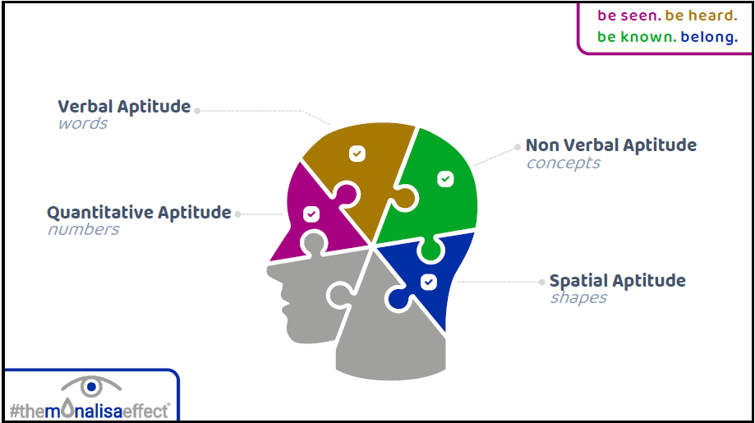
Notes:
It helps educators tailor teaching, identify students who need extra support or challenges, and set academic targets, providing a broader view of a student's abilities beyond traditional curriculum-based tests.

Slide 13
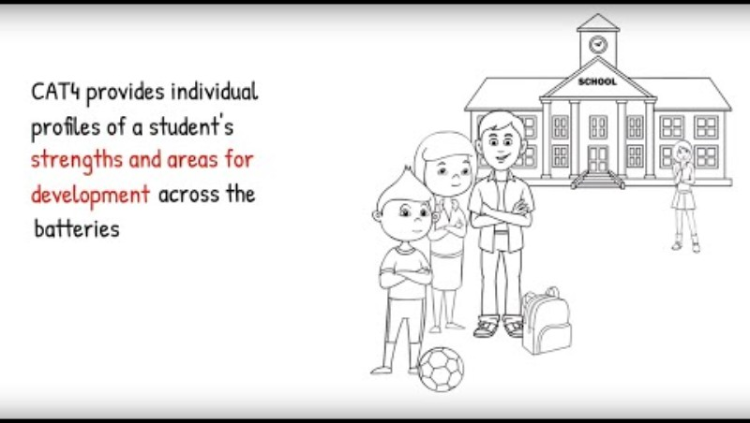

Slide 14
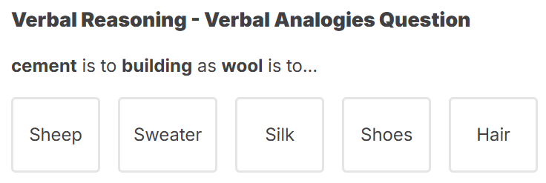
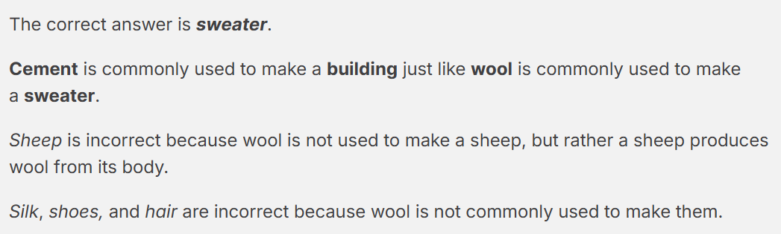
Sample Questions Website
Notes:
In each question, the words A and B relate to each other in a specific way. Student must identify this relation, and apply it to word C by selecting the fourth word from five given answer choices that is best suited.

Slide 15
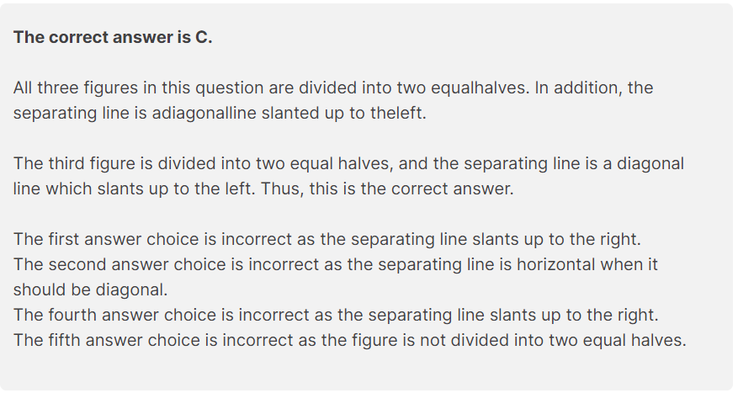

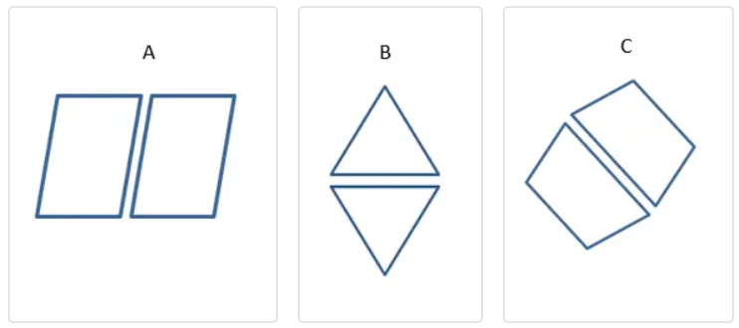
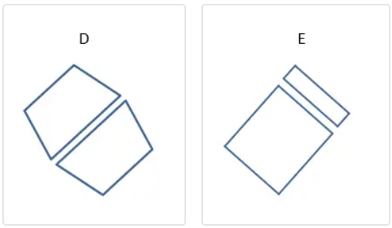
Non-Verbal Reasoning Question
A
B
C
D
E

Slide 16
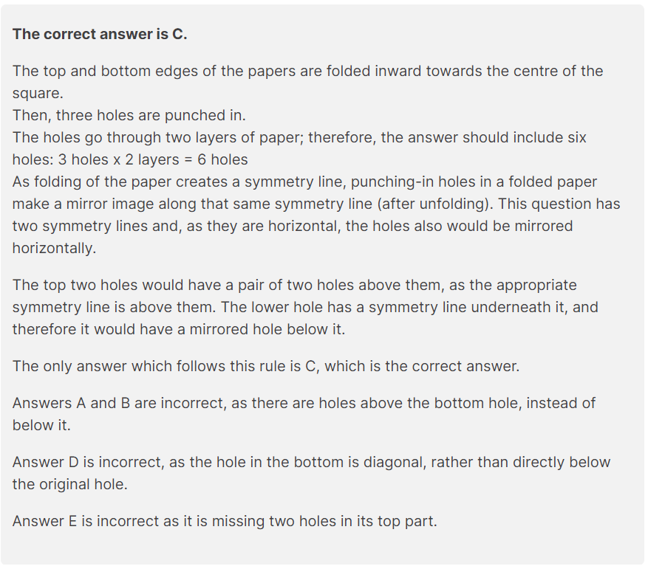
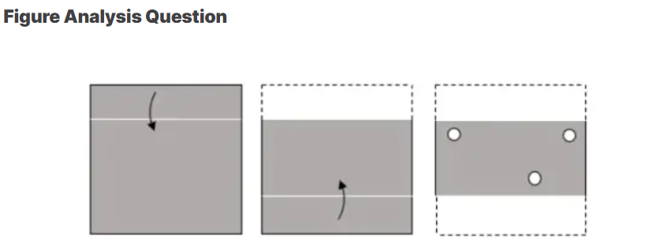
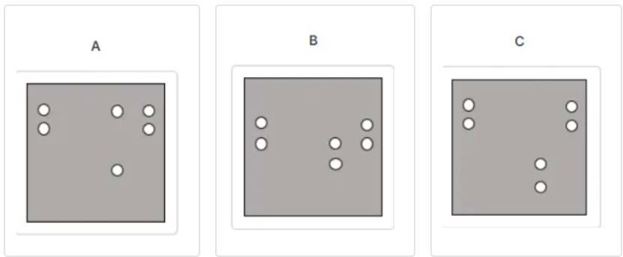
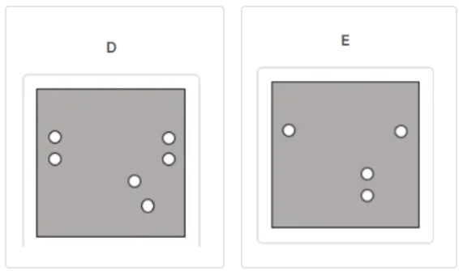
Spatial Reasoning Question
A
B
C
D
E
Notes:
The top and bottom edges of the paper is folded towards the centre of the square.
Which image would match the paper when it is completely unfolded?

Slide 17
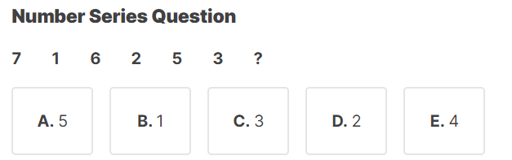
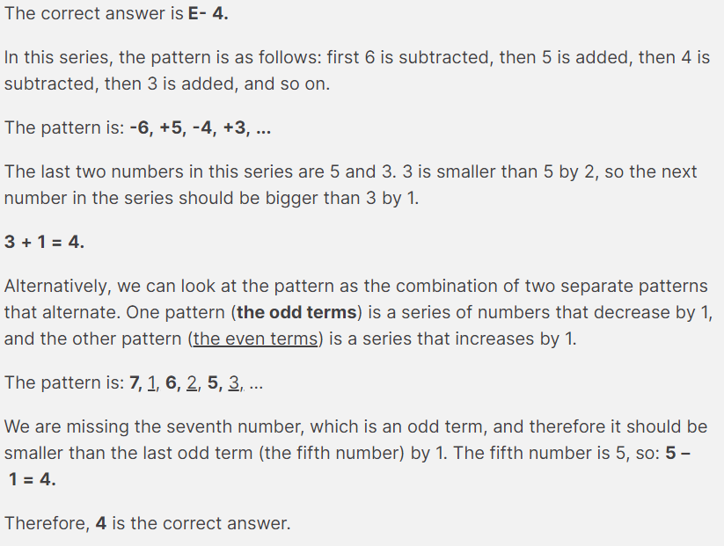
Notes:
What is the next number in the series?

Slide 18
RECORDING

Slide 19
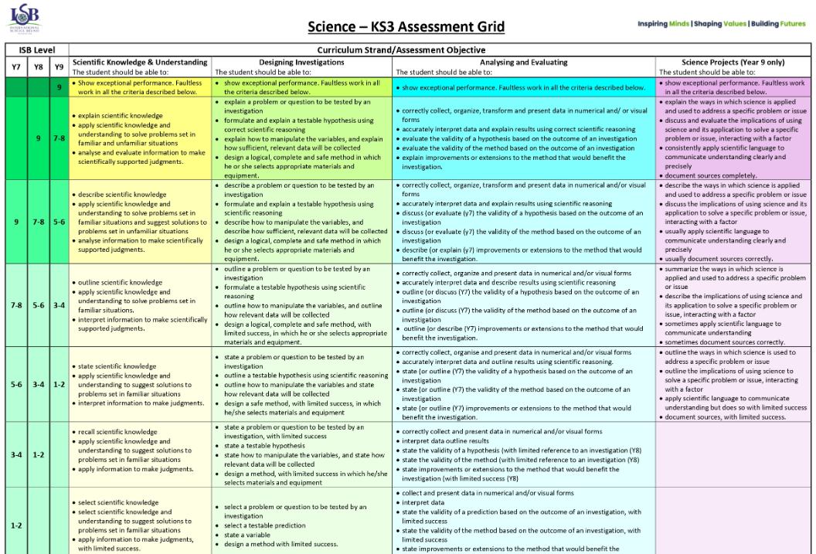
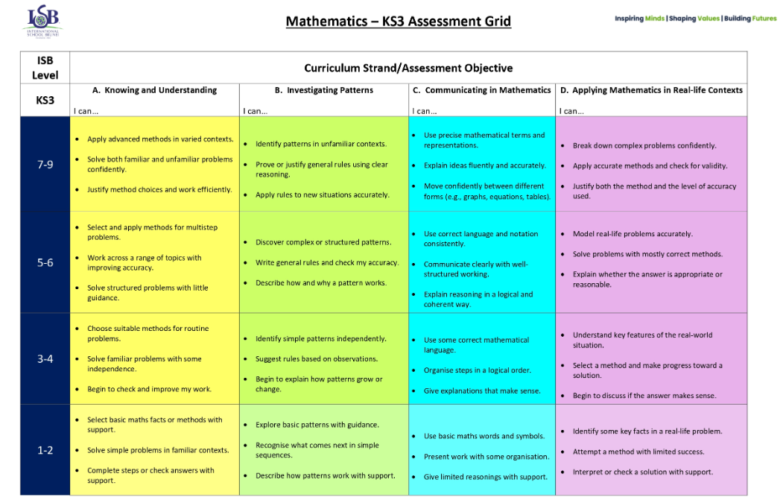
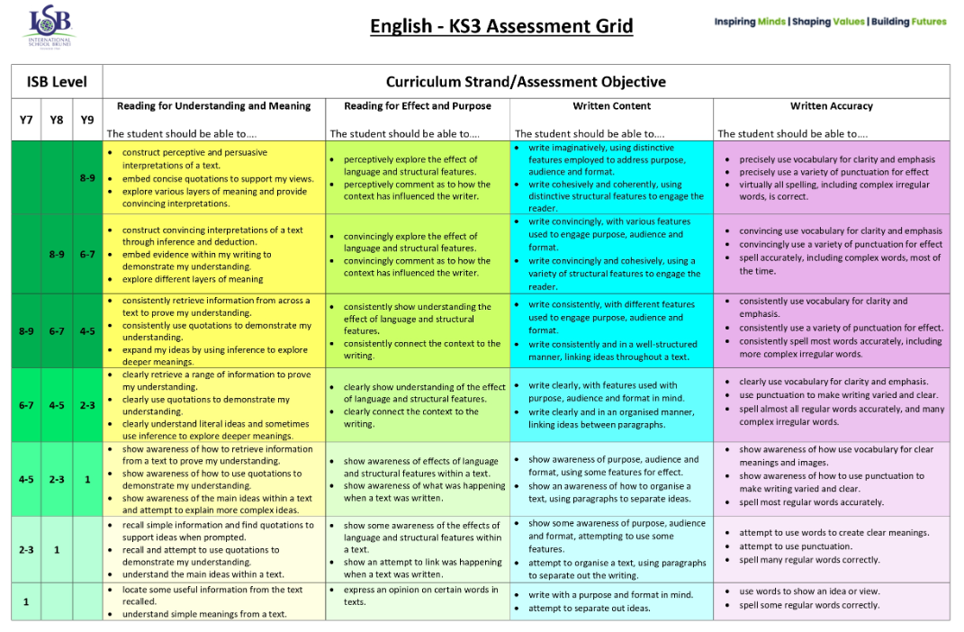
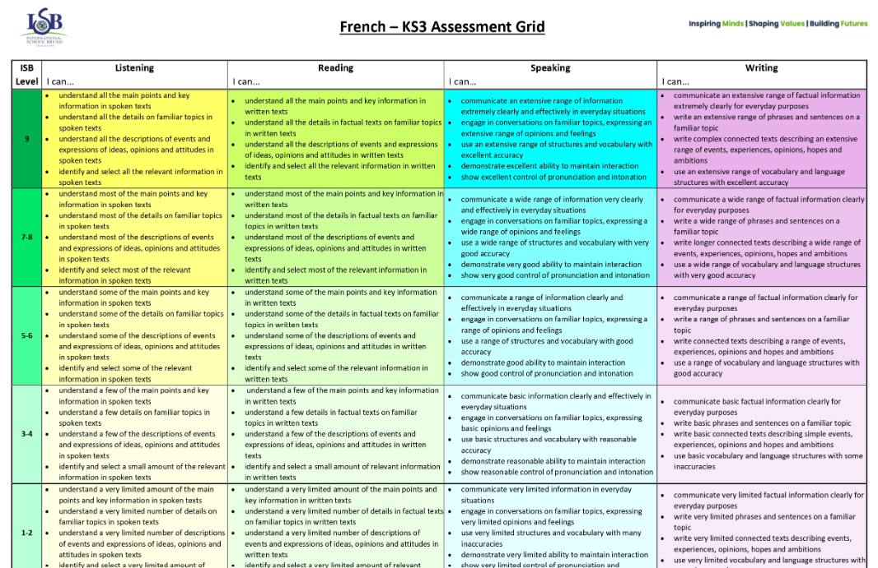
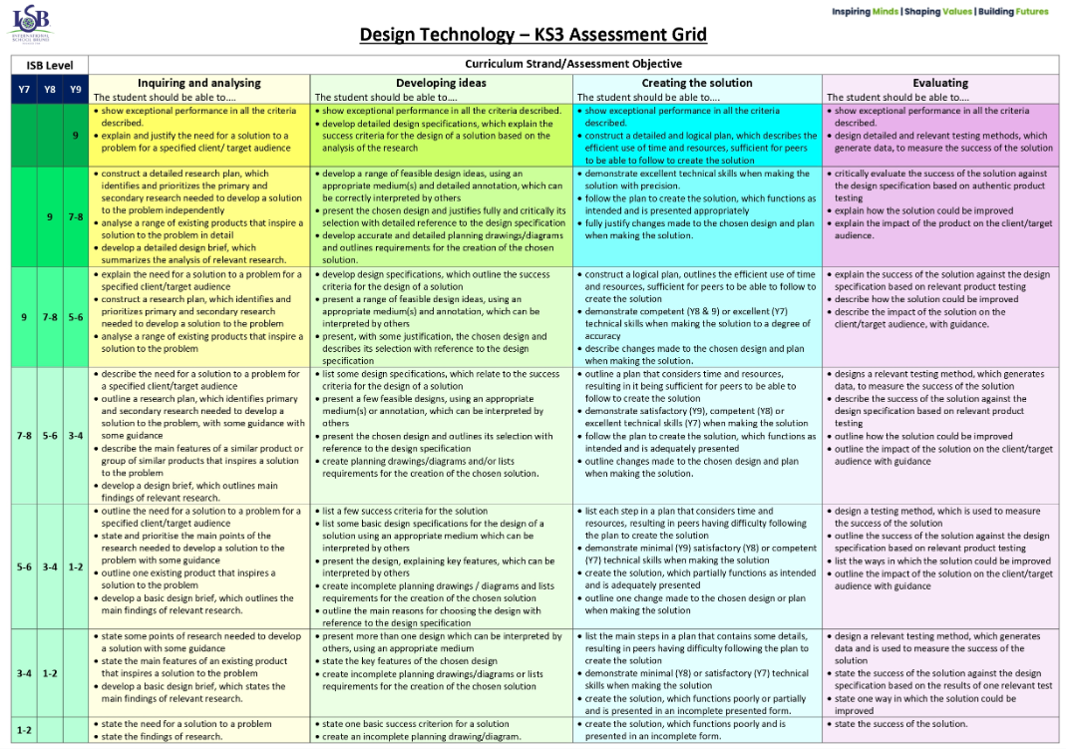
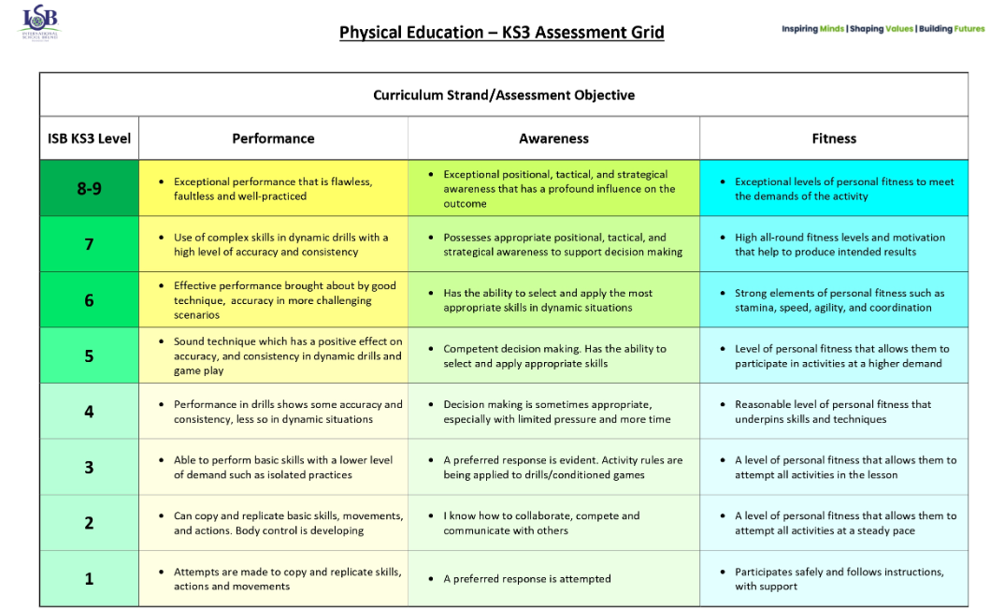
KS3 Assessment rubrics
Notes:
Eng, Math, Sci, French, DT & PE
IGCSE subjects are assessed against subject specific exam board criteria
IB subjects assessed against subject specific IB criteria and the Core levels

Slide 20
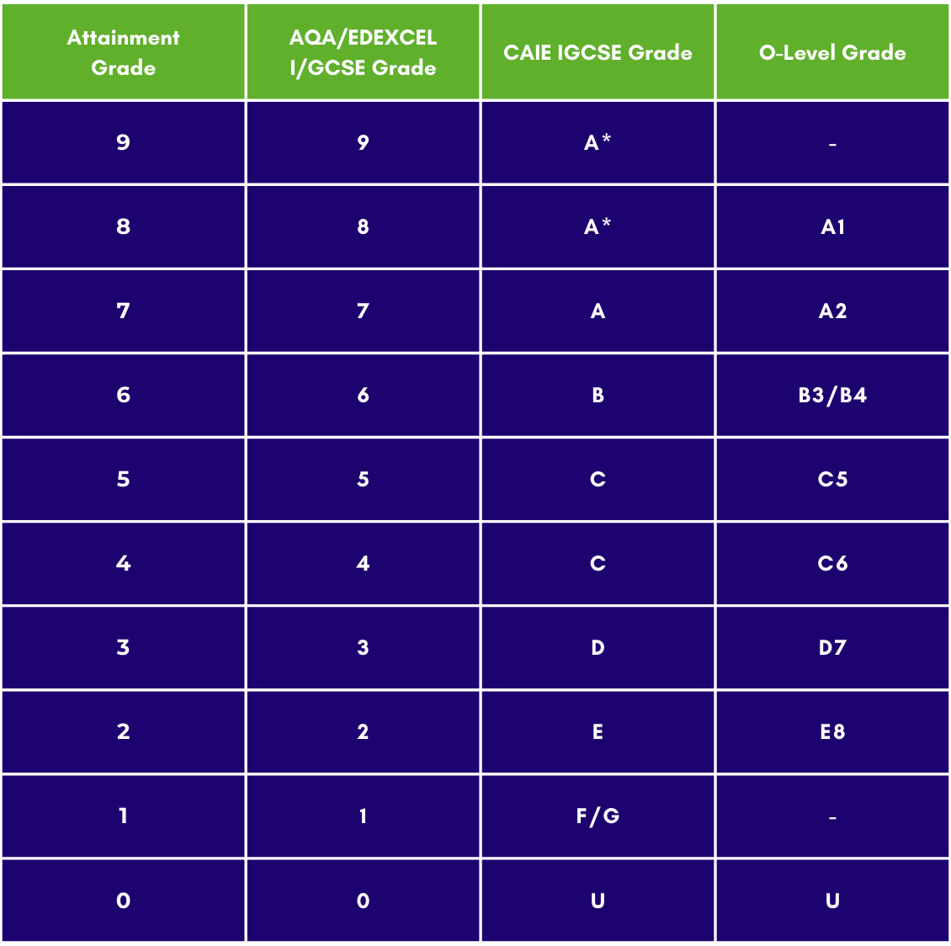
Grade Equivalency

Slide 21
REPORTING

Slide 22
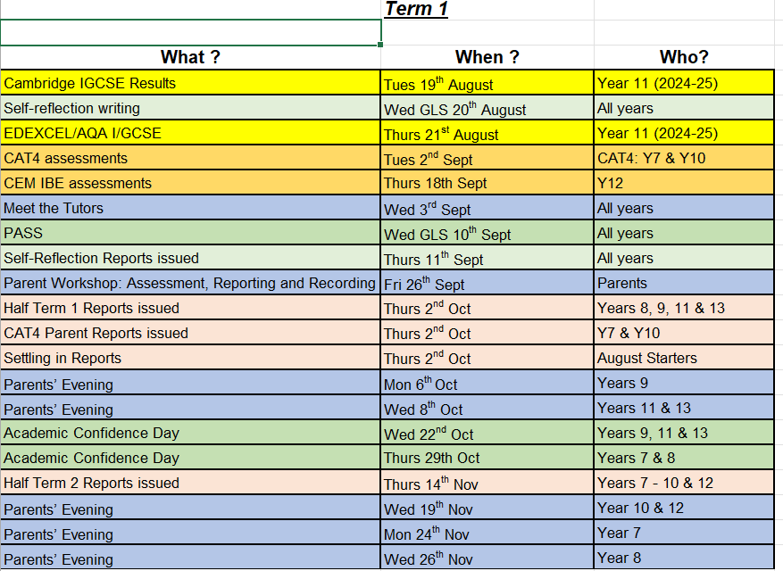
Reporting – the Reporting Calendar
Data Drop 1
Data Drop 2
Notes:
https://acisbedu-my.sharepoint.com/:x:/g/personal/sbromley_ac_isb_edu_bn/EeFTTGpb8HBFoXZZ1kNTctsBKoBqDIVmbsd4LKe2SMHBLA?e=5CfGjf

Slide 23
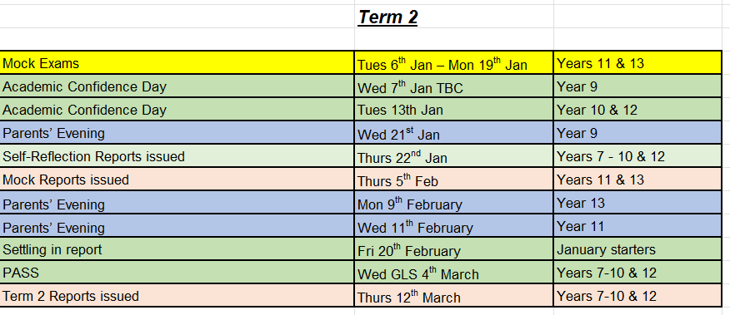

Reporting – the Reporting Calendar
Data Drop 3
(mock results)
Data Drop 3
Notes:
https://acisbedu-my.sharepoint.com/:x:/g/personal/sbromley_ac_isb_edu_bn/EeFTTGpb8HBFoXZZ1kNTctsBKoBqDIVmbsd4LKe2SMHBLA?e=5CfGjf

Slide 24
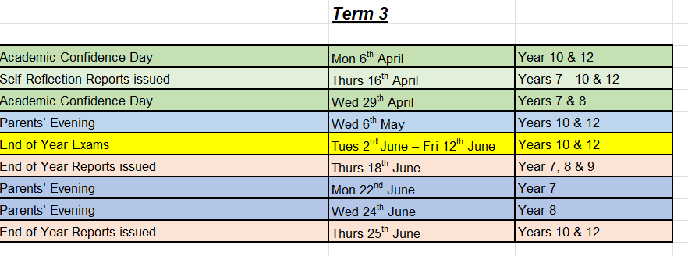
Reporting – the Reporting Calendar
Data Drop 4
Notes:
https://acisbedu-my.sharepoint.com/:x:/g/personal/sbromley_ac_isb_edu_bn/EeFTTGpb8HBFoXZZ1kNTctsBKoBqDIVmbsd4LKe2SMHBLA?e=5CfGjf

Slide 25


Reporting – annual cycle & PTMs
When | Year 7 | Year 8 | Year 9 | Year 10 | Year 11 | Year 12 | Year 13
HT 1 |  | ✓ | ✓ |  | ✓ |  | ✓
HT 2 | ✓ | ✓ | ✓ | ✓ |  | ✓
HT 3 |  |  |  |  | ✓ |  | ✓
HT 4 | ✓ | ✓ | ✓ | ✓ |  | ✓
HT 5
HT 6 | ✓ | ✓ | ✓ | ✓ |  | ✓
PTMs – 2 per year

Slide 26
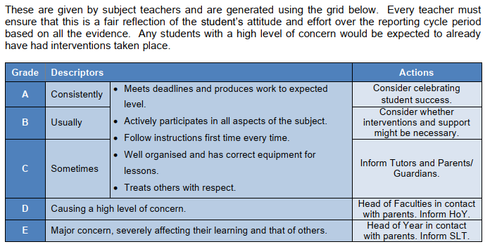
Progress Reports - Effort Grades

Slide 27
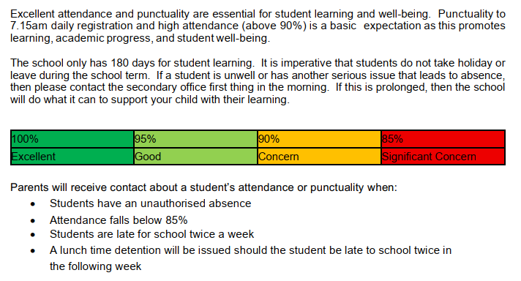
Progress Reports – Attendance & Punctuality

Slide 28
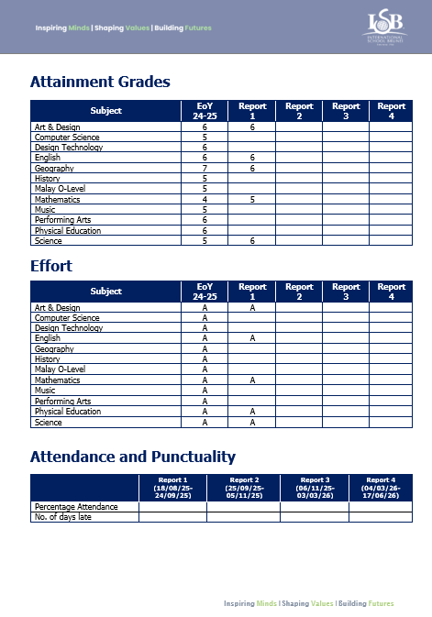
Progress Reports
- Attainment Grades

Slide 29

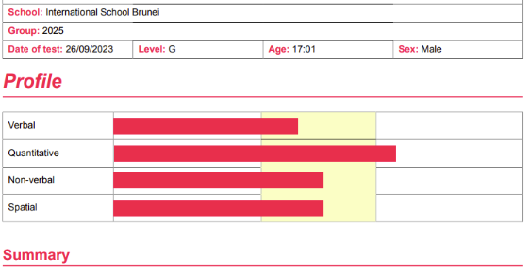
CAT4 Parent reports
Y7-11
Shared via EduLink on 2nd October

Slide 30
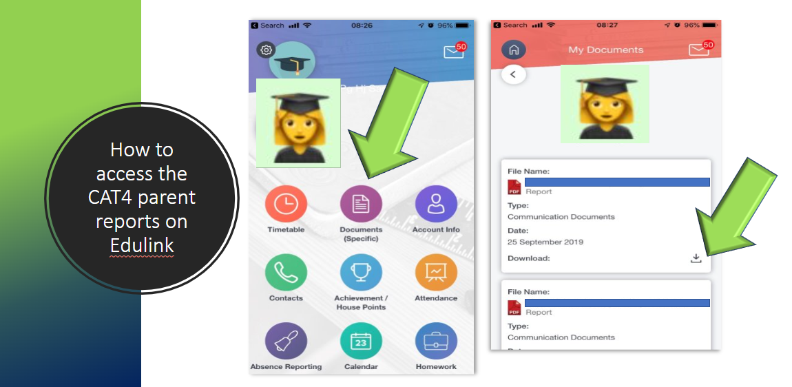
Accessing CAT4 Parent reports

Slide 31
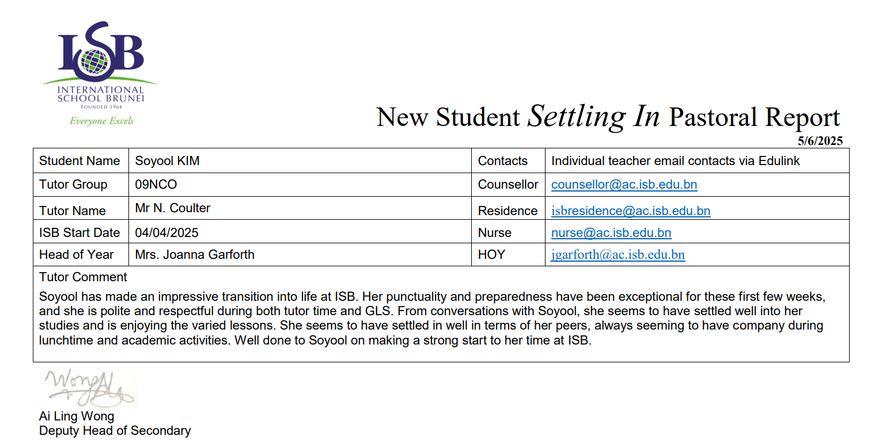

Settling reports
New students only Y7-13
Shared via EduLink on 2nd October

Slide 32

Playtime
Go to www.blooket/play
Please enter using the code:
Add ‘sensible names’ please class

Slide 33


Check out : Assessment Recording & Reporting (and all things ISB) on the ISB Wix Parent site here
Contact me on: sbromley@ac.isb.edu.bn
Or
Call the Secondary office

